Slide 1

Smart Parking System
PUSL2003 Integrating Project
19.1 Group - 54

Slide 2
Project Idea
Introduction
There is almost no space for parking, and they are bit difficult to find. This system can Identified Primarily by the number plates of the vehicles which obtain the driver details. Almost drivers can use any parking space from one place .
Key features
Everything is monitored from the moment the vehicle enter the park.
Security can Open to gate for Successfully vehicles
Desktop Application can add new parking location ,and it can change every Mobile database value.
Drivers can view the available spots and guidelines for parking .
Camera provide the security and the l monitoring vehicle.
Arduino bord LED panel is showing vehicle parking status.
Google map Using driver can navigate parking locations.
Database for using Docker Container with MySQL .
Chat system is Using to Connect with Security
19.1 Group - 54

Slide 3




Mobile Application
Security Side
get http clints
Get http clints
Login
Login/Registration
Dashboard
Dashboard
send http clints
ANSPR
Other Options
Other Options
Oder the Parking
get http clints
Image Processing
19.1 Group - 54

Slide 4
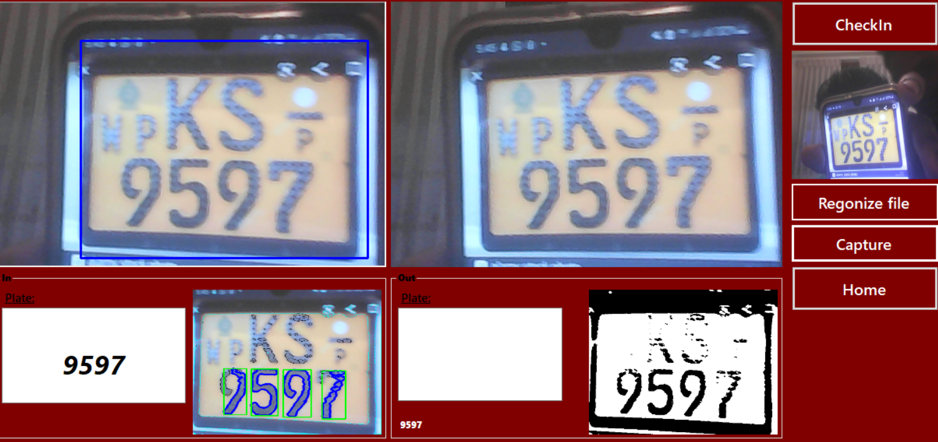
Member – 01 (10707373)
Image Processing using Monitored Vehicle Number plate.
Checking the driver vehicle number plate and Monitored Vehicle Number plate .
Generate a signal for Arduino successfully and open the parking gate.
Design a UI similar Main desktop Application.
What is a using technology
This is developed for using by C# .NET and Emgu CV.
Mainly image for ident find OCR transcription methods.
19.1 Group - 54

Slide 5
Architect detect Plate (OCR transcription)
Load Image
Characting training
Pre-Image Processing
Load training
Image
Convert to Binary
Get feature data
Draw React around object
training
Find the React we suspect as license plate
Save SMV training file
Recognize Character base on SVM Predicate
19.1 Group - 54

Slide 6
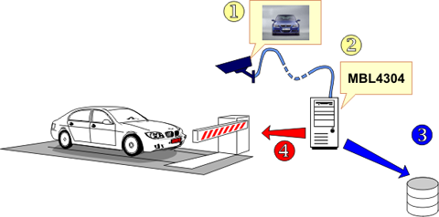
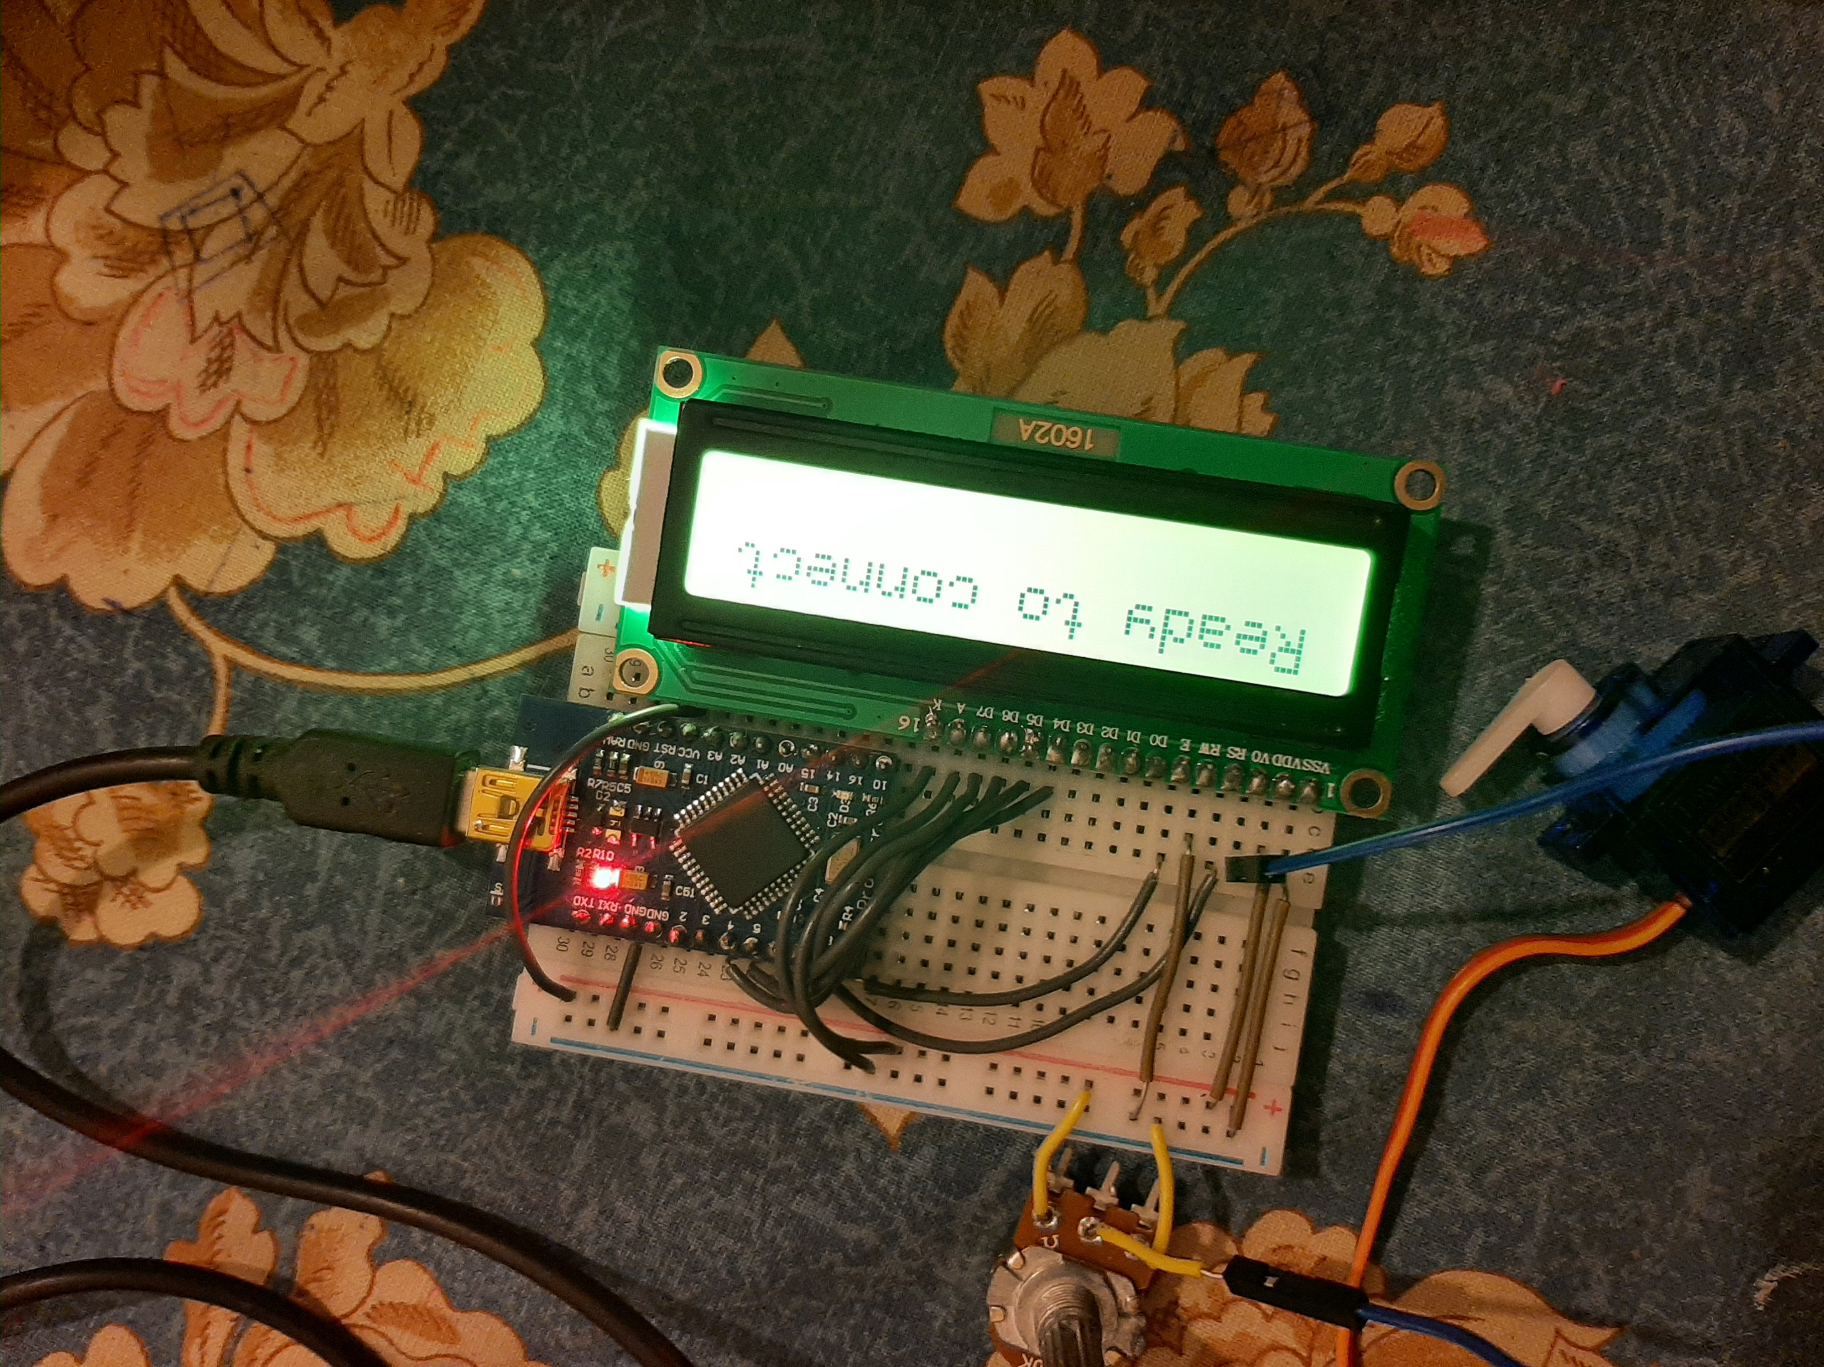
Arduino
components
Arduino Leonardo board
LCD Board
Sever motor
Bread Board
USB cable
How to connect with system
This is for using serial communication method
19.1 Group - 54

Slide 7
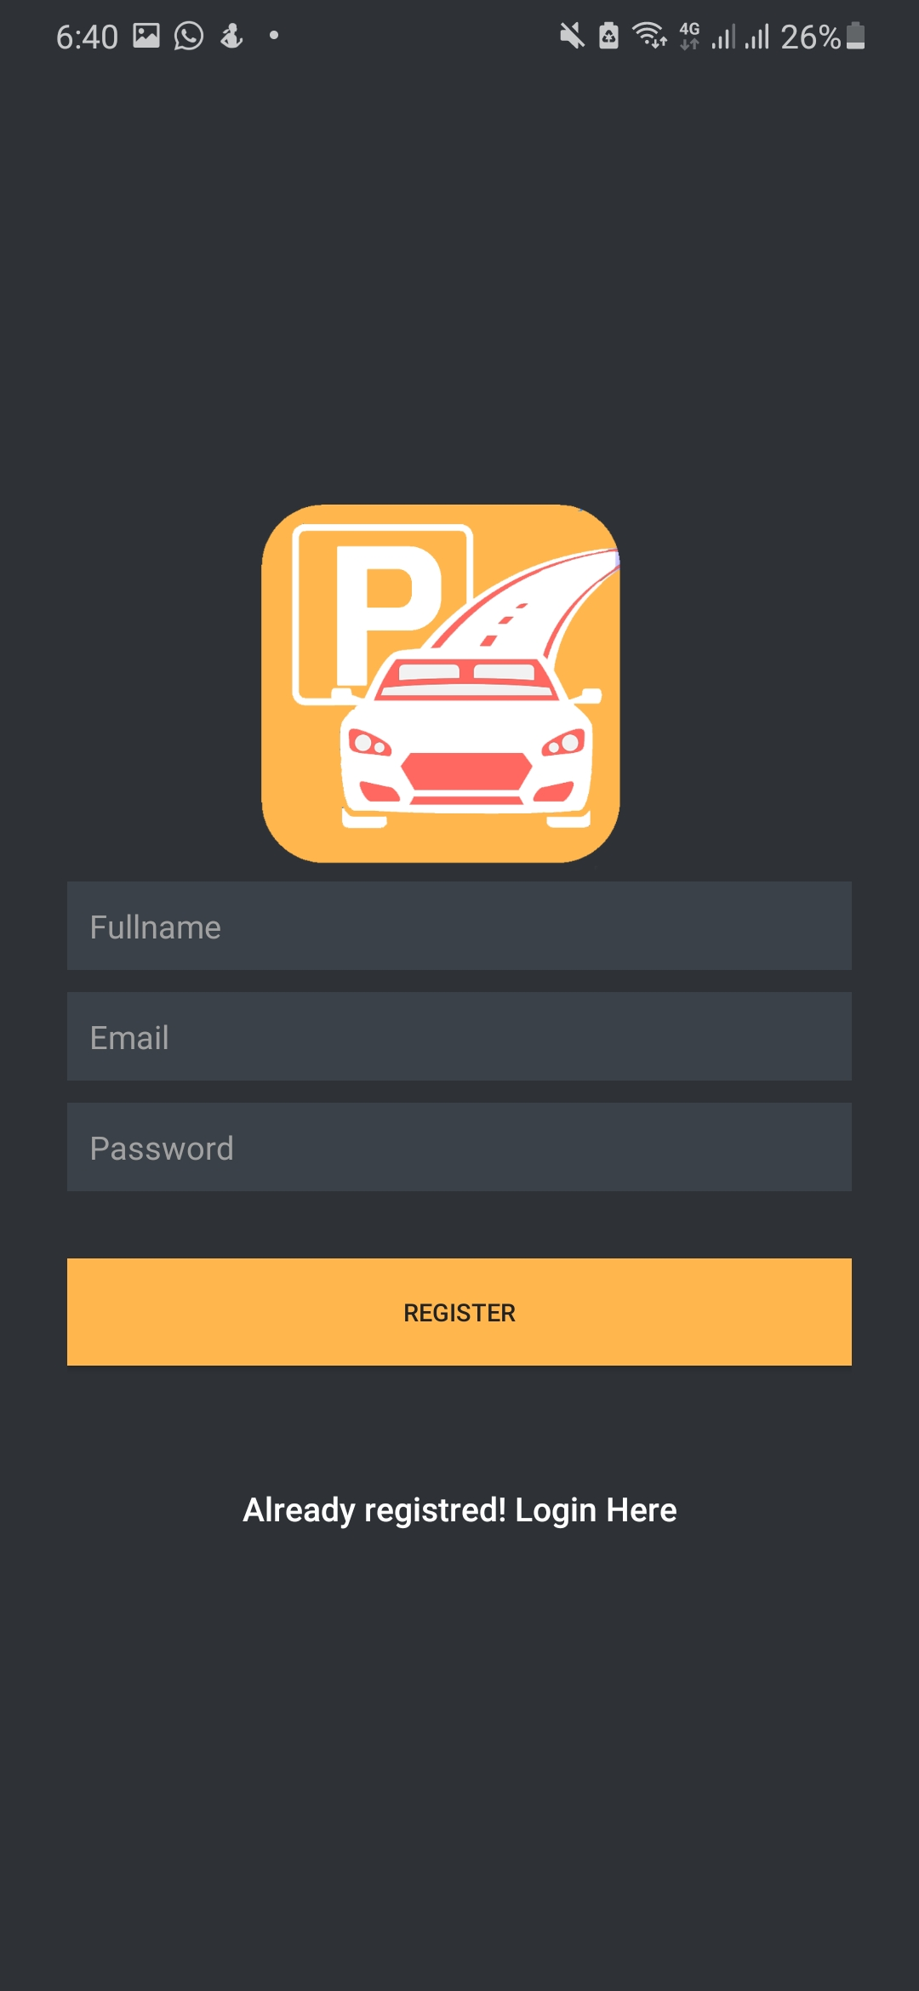
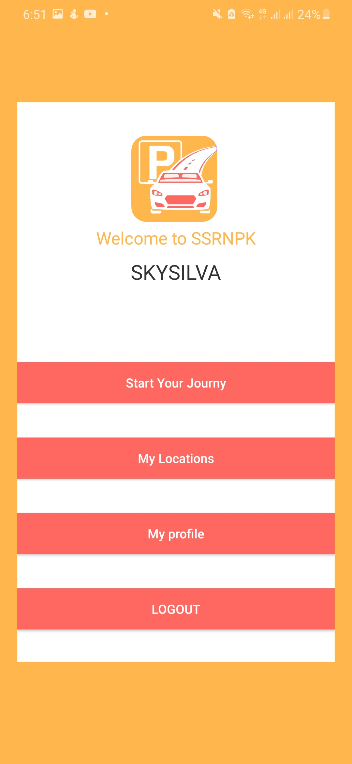
Member – 02 (10707391)
Mainly using android studio Java and back end for php
App every Database components are connected with MySQL data base
Driver Can create new account and login
Drivers can Show own profile and His Old payment history's.
Driver can Select parking and odder the parking area .
19.1 Group - 54

Slide 8


Member – 03 (10707128)
Desktop Application
Database
Docker HTTP Prots to Connect Database.
Docker HTTP /TCP Transferer local sever
Mobile Application
Local sever
Docker Container MYSQL
19.1 Group - 54

Slide 9
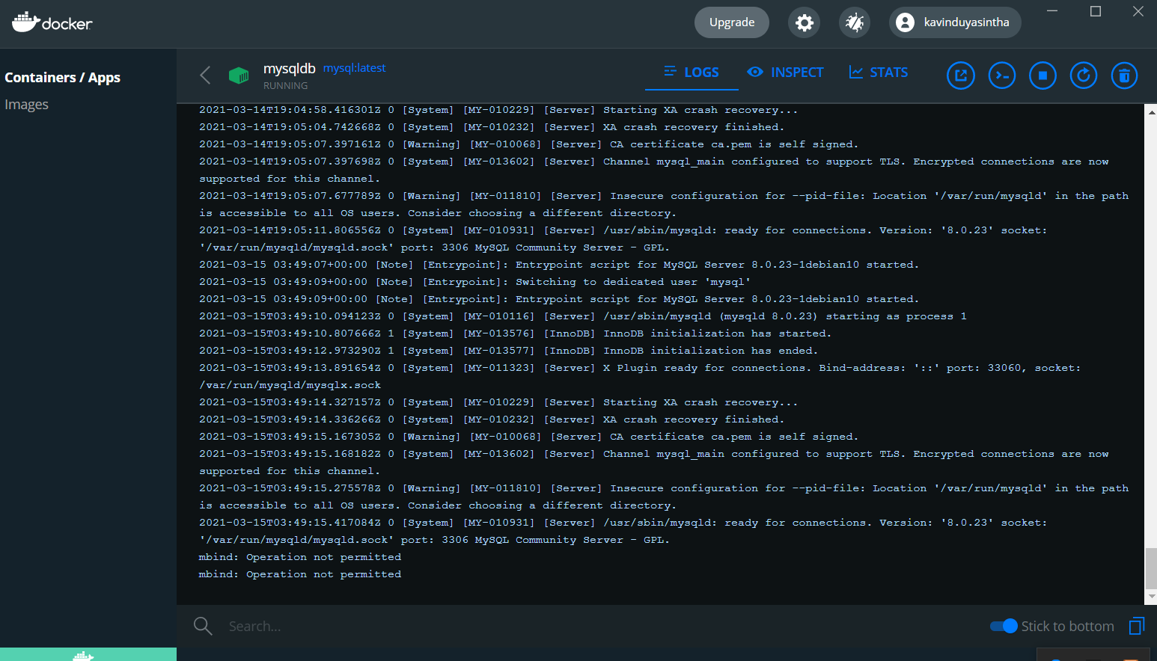
Desktop and mobile application for using Docker Container with MYSQL
Using A Local TCP protocol Local Saver (https //192.3……./ )
Mobile application database Data send with
This Network Act by WAN
MySQL interface for using MYSQL WORKBENCH
This system For we using ER Diagram and identing entity
19.1 Group - 54

Slide 10
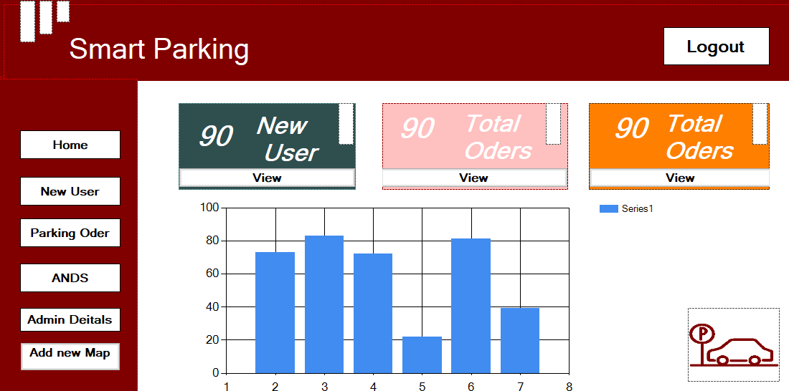
Member – 04 (10707095)
Desktop
Using C# .NET Framework
Every Interface create by Security for help
Mainly Has Admin Login in and it is protecting Security data
Security can show Oder Table Payment table , and Update delete
Mainly Security can add new Parking Locations and His can Using update delete ever function
Mainly Security has a dashboard, and it can essay to access user details
19.1 Group - 54

Slide 11

Member – 05 (10707165)
Map location
This Map location Using by mobile application mainly using Google map API for this.
This development for mainly get Manifest Access for location premotions.
After Create the Oder and Deriver Can drive Tow Distances using google map.
19.1 Group - 54

Slide 12
Member – 06 (10707295)
Verification OTP
This is for using Firebase OTP .
This Usually want complete the Parking Oder
OTP for sending Method is a Mobile Phone
19.1 Group - 54

Slide 13
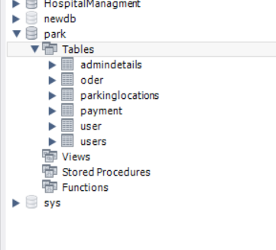
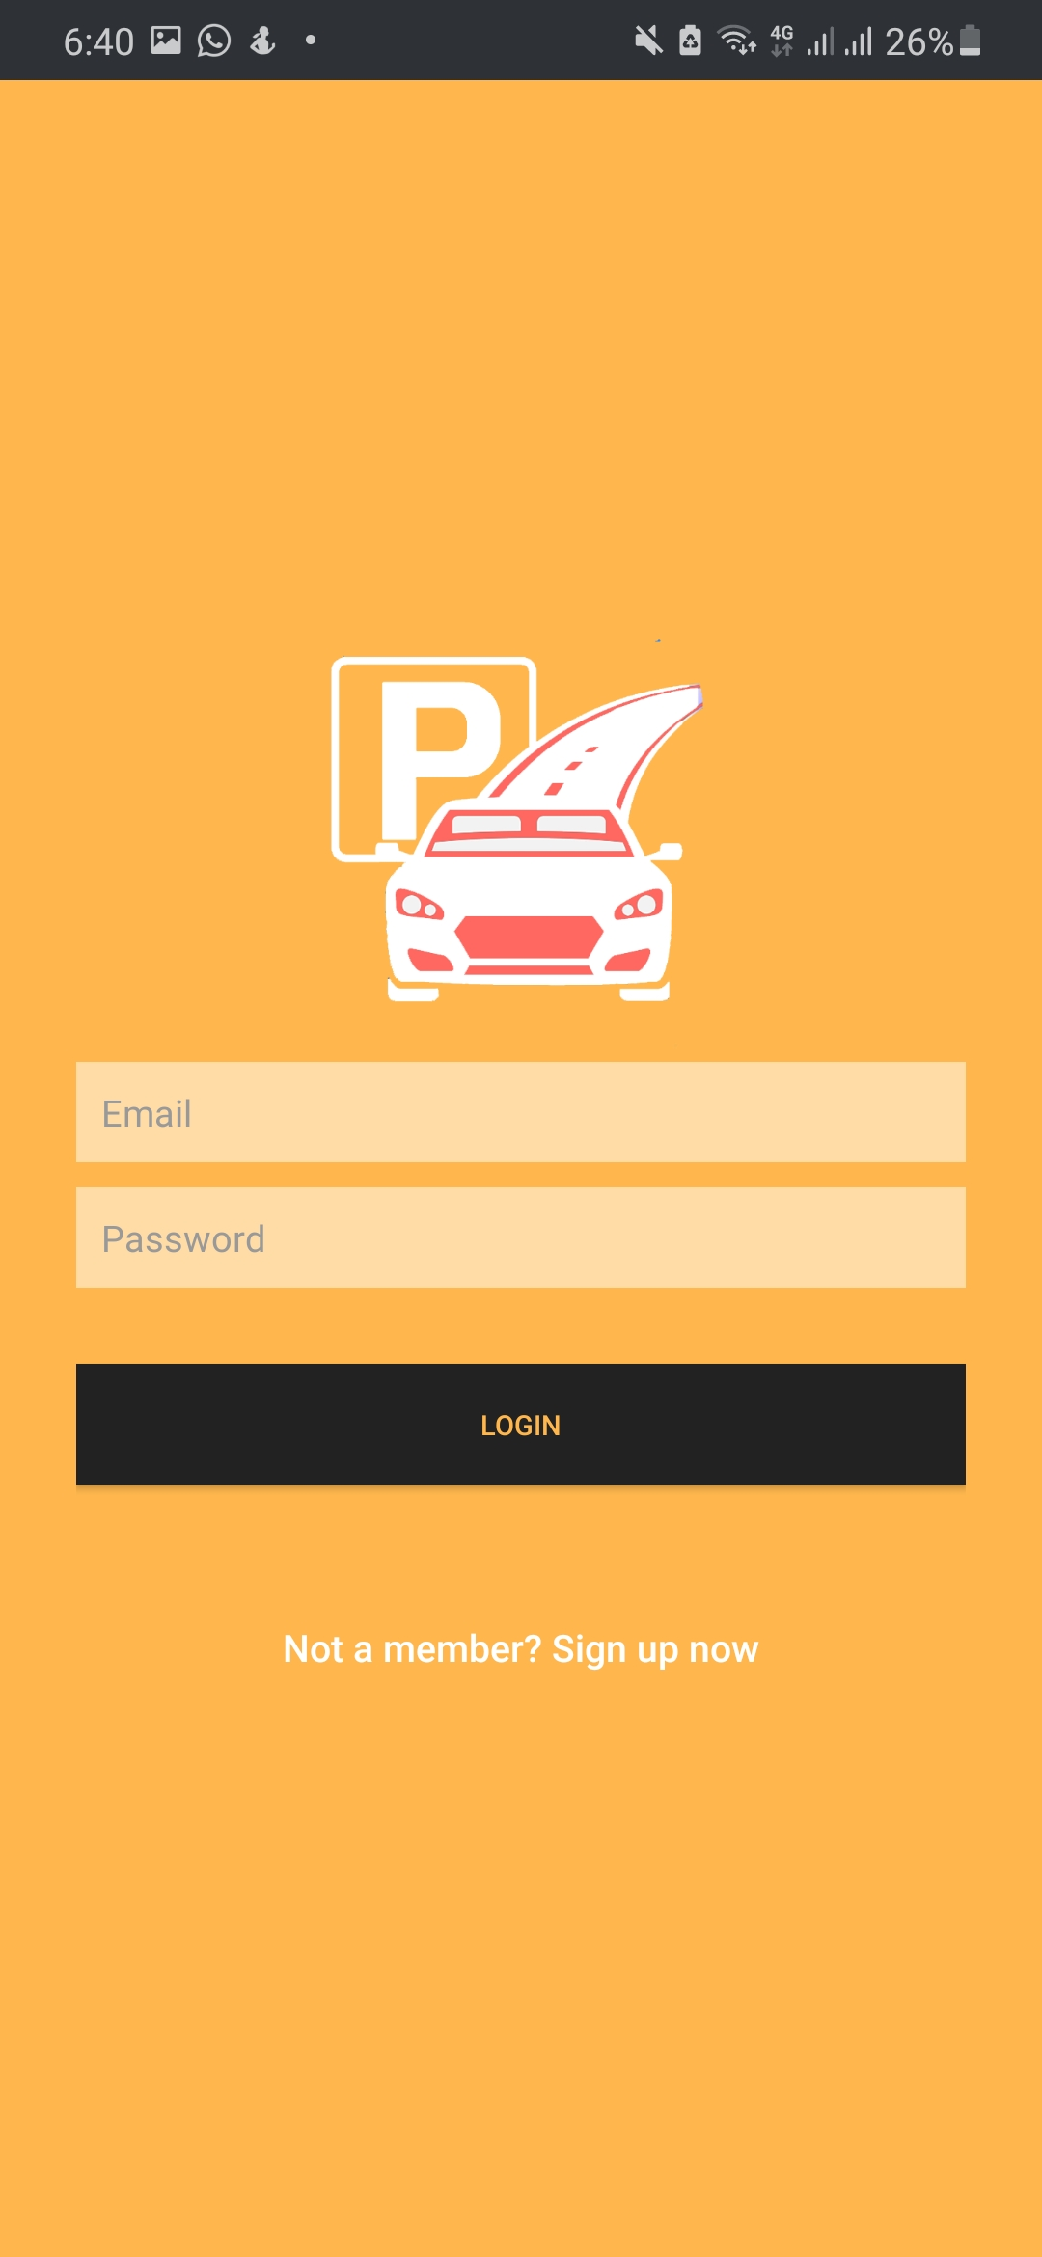
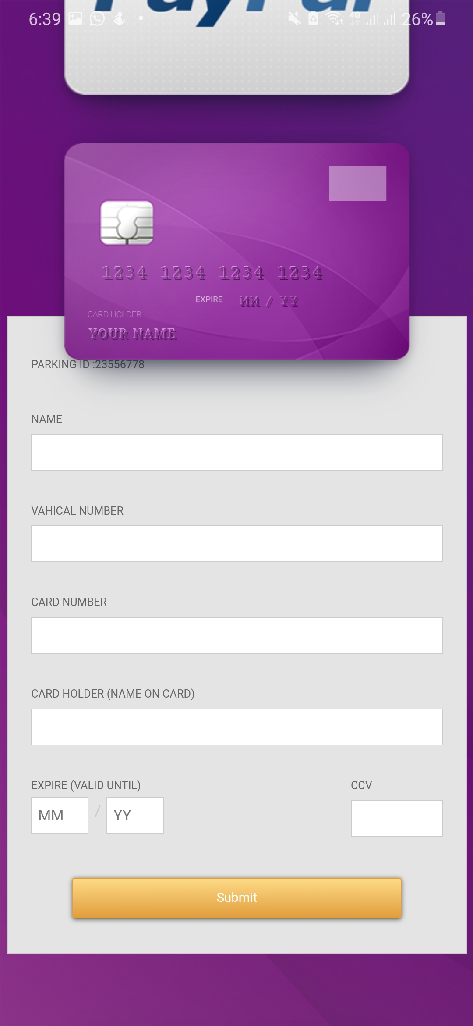
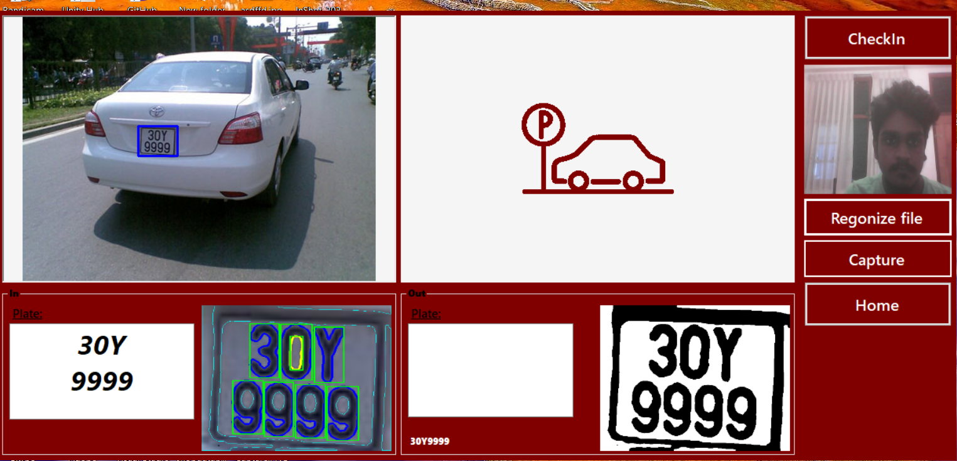
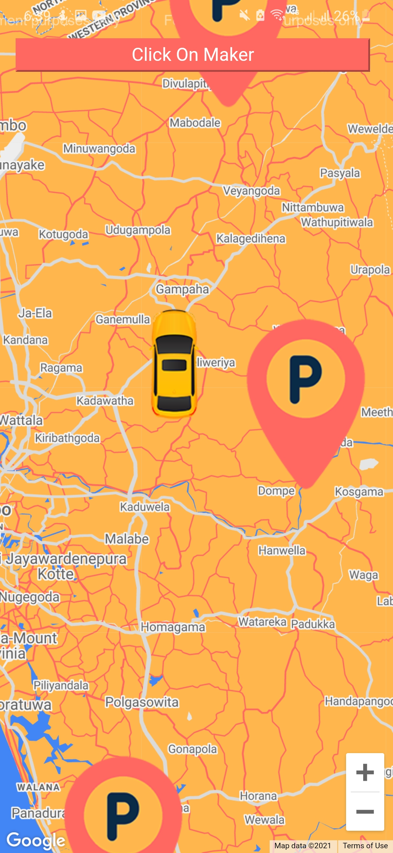
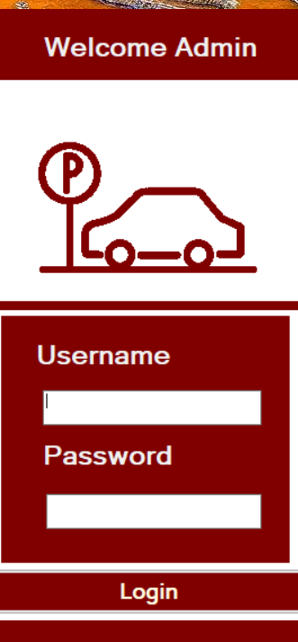
Current progress
90% Completed
19.1 Group - 54

Slide 14
Team member details
Plymouth index no | Name | Tasks carried out
10707373 | S.K.Y Silva | Chapter 6 - Development tools and technology
10707128 | R.G.K.D Amarasooriya | Chapter 2 - System Analysis
10707391 | H.W.N Thathsara | Chapter 1 - Introduction
10707165 | P.N De Silva | Chapter 4 - Feasibility Study
10707095 | G.M.S Lakshan | Chapter 3 - Requirement Specification
10707295 | R.D Paranawithana | Chapter 5 - System architecture
19.1 Group - 54

Slide 15
Thank you !
19.1 Group - 54

